Slide 1
E-COMMERCE CUSTOMER SEGMENTATION AND PREDICTION
~ Nishita Thingalaya

Slide 2

Introduction
Customer segmentation is a critical process in marketing and business strategy. It involves dividing a customer base into distinct groups that share similar characteristics, behaviors, or preferences. This segmentation helps businesses tailor their marketing efforts, optimize customer engagement, and maximize revenue.
Objective
The objective of this project is to analyze customer purchasing behaviors using clustering techniques and identify meaningful segments that can be used for targeted marketing and retention strategies.

Slide 3

Dataset Overview
The dataset used in this project contains transactional data from a retail business. The key attributes include:
Customer ID: Unique identifier for each customer.
Transaction Date: The date of purchase.
Monetary Value: The total amount spent by the customer.
Frequency: The number of transactions made by each customer.
Recency: The number of days since the last purchase.
Understanding these attributes allows us to apply meaningful customer segmentation techniques.

Slide 4

Data Preprocessing & Feature Engineering
Data preprocessing is an essential step before analysis to ensure the quality of insights derived. The following steps were taken:
Handling Missing Values: Missing values were identified and removed or imputed where necessary.
Outlier Detection & Removal: The Interquartile Range (IQR) method was applied to remove extreme values that could skew our results.
Feature Engineering: The dataset was transformed to create three key features based on the RFM model:
Recency (R): How recently a customer made a purchase.
Frequency (F): How often a customer purchases.
Monetary (M): How much a customer spends.
These features form the foundation for customer segmentation analysis.

Slide 5
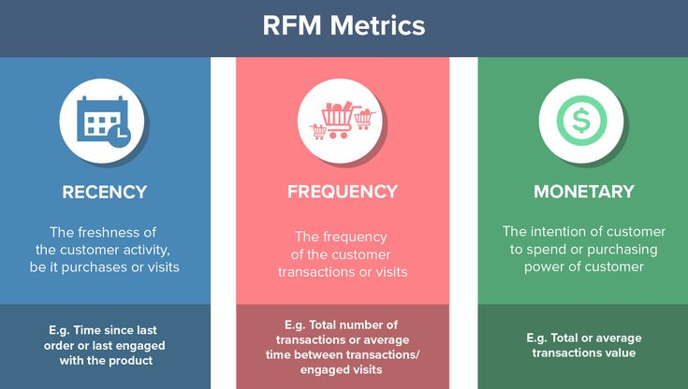

Slide 6
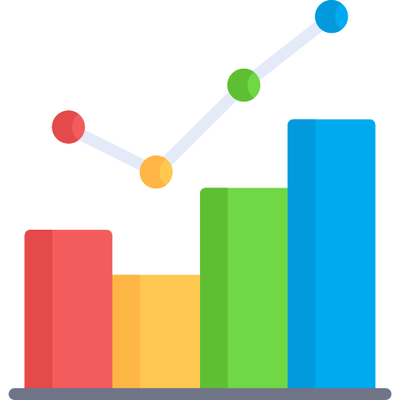
Exploratory Data Analysis (EDA)
Before implementing clustering models, exploratory data analysis was performed to understand customer behavior:
Summary Statistics:
Average purchase frequency was analyzed.
The distribution of monetary values and recency was examined.
Data Visualization:
Histograms and boxplots were used to examine spending patterns.
A correlation matrix was created to explore relationships between RFM attributes.
Key insights from EDA revealed that:
A majority of customers are infrequent buyers.
A small percentage of customers contribute to a large portion of revenue.
There is a clear distinction between high-value and low-value customers.

Slide 7

Clustering Algorithms Used
Several clustering methods were applied to segment customers based on the RFM values:
K-Means Clustering: This algorithm was used to partition customers into distinct groups based on purchasing behavior.
Hierarchical Clustering: Provided insights into natural customer groupings by forming a dendrogram.
DBSCAN: Used to detect outliers and identify dense clusters.

Slide 8

Best Clustering Model Selection
The effectiveness of the clustering models was evaluated using:
Elbow Method: To determine the optimal number of clusters in K-Means.
Silhouette Score: To measure the cohesion and separation of the clusters.
Based on these evaluations, the best model was selected to provide the most meaningful customer segmentation.

Slide 9
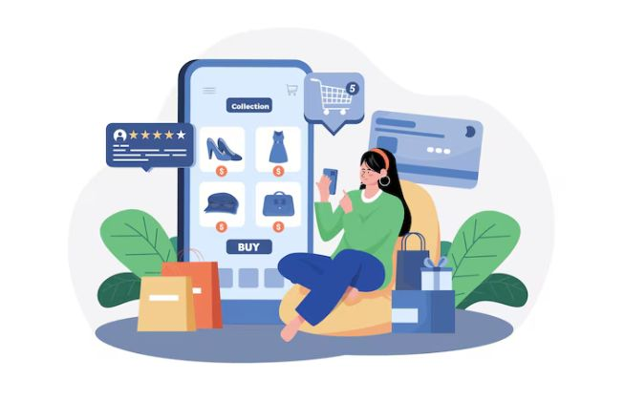
Insights from Customer Segments
After clustering, three primary customer segments were identified:
High-Value Loyal Customers
Frequent buyers with high monetary value.
Represent a small percentage of customers but contribute significantly to revenue.
Occasional Buyers:
Moderate frequency and recency.
Potential to be converted into loyal customers with targeted promotions.
Churned Customers:
Long recency period with low frequency and monetary value.
Require re-engagement strategies to bring them back.

Slide 10

Actionable Recommendations
Based on the identified segments, the following strategies are suggested:
For High-Value Customers:
Implement loyalty programs with exclusive rewards.
Provide VIP discounts and early access to sales.
For Occasional Buyers:
Send personalized offers and reminders to encourage repeat purchases.
Use targeted email marketing campaigns.
For Churned Customers:
Offer time-sensitive discounts to re-engage them.
Conduct customer feedback surveys to understand their needs.

Slide 11

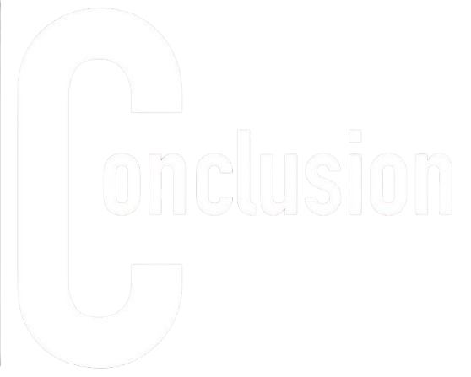
Conclusion & Future Work
Conclusion:
Customer segmentation is crucial for optimizing marketing strategies and customer retention.
Using clustering techniques, we identified key customer groups and tailored marketing strategies accordingly.
Future Work:
Implementing additional machine learning models for customer behavior prediction.
Integrating Power BI for advanced visualization and reporting.
Expanding the dataset to incorporate demographic information for deeper insights.

Slide 12
Thank You!

